Slide 1

Welcome to BookMyMandap: Your Dream Venue Awaits
Discover the hassle-free way to find and book Mandaps, designed to connect users and providers effortlessly. Our platform creates seamless event experiences by simplifying the entire venue booking journey.

Slide 2

The Problem: Traditional Venue Booking is a Headache
Time-Consuming Searches
Lack of Transparency
Pricing and venue availability remain unclear, frustrating users and providers alike.
Users spend over 40 hours navigating through scattered information, making endless phone calls to find a suitable Mandap.
Disorganized Process
Poor communication and outdated listings result in inefficient booking experiences.

Slide 3
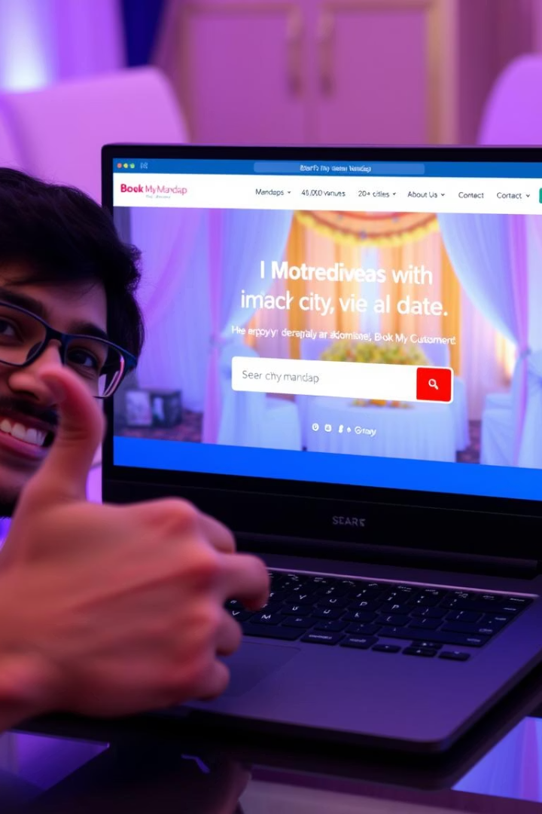
Our Solution: BookMyMandap - Simplifying Venue Booking
Unified Platform
Streamlined Experience
Connecting users directly with Mandap providers on a single easy-to-use platform.
Efficient search, booking, and management tools reduce time and effort.
Transparent & Organized
Clear pricing, availability, and secure transactions ensure trust and convenience.

Slide 4



Technology Stack Behind BookMyMandap
Frontend Technologies
React.js for dynamic UI
Sonner for elegant notifications
Backend & Database
React Big Calendar for scheduling
Node.js runtime server-side
Recharts for visual data
Express.js API framework
Moment.js for date handling
Bcrypt for password security
Ant Design UI components
Nodemon for live reloads
Zustand for state management
JWT for secure authentication
Typewriter-effect for animations
MongoDB for NoSQL data storage
React Router for navigation
Tailwind CSS for fast styling

Slide 5
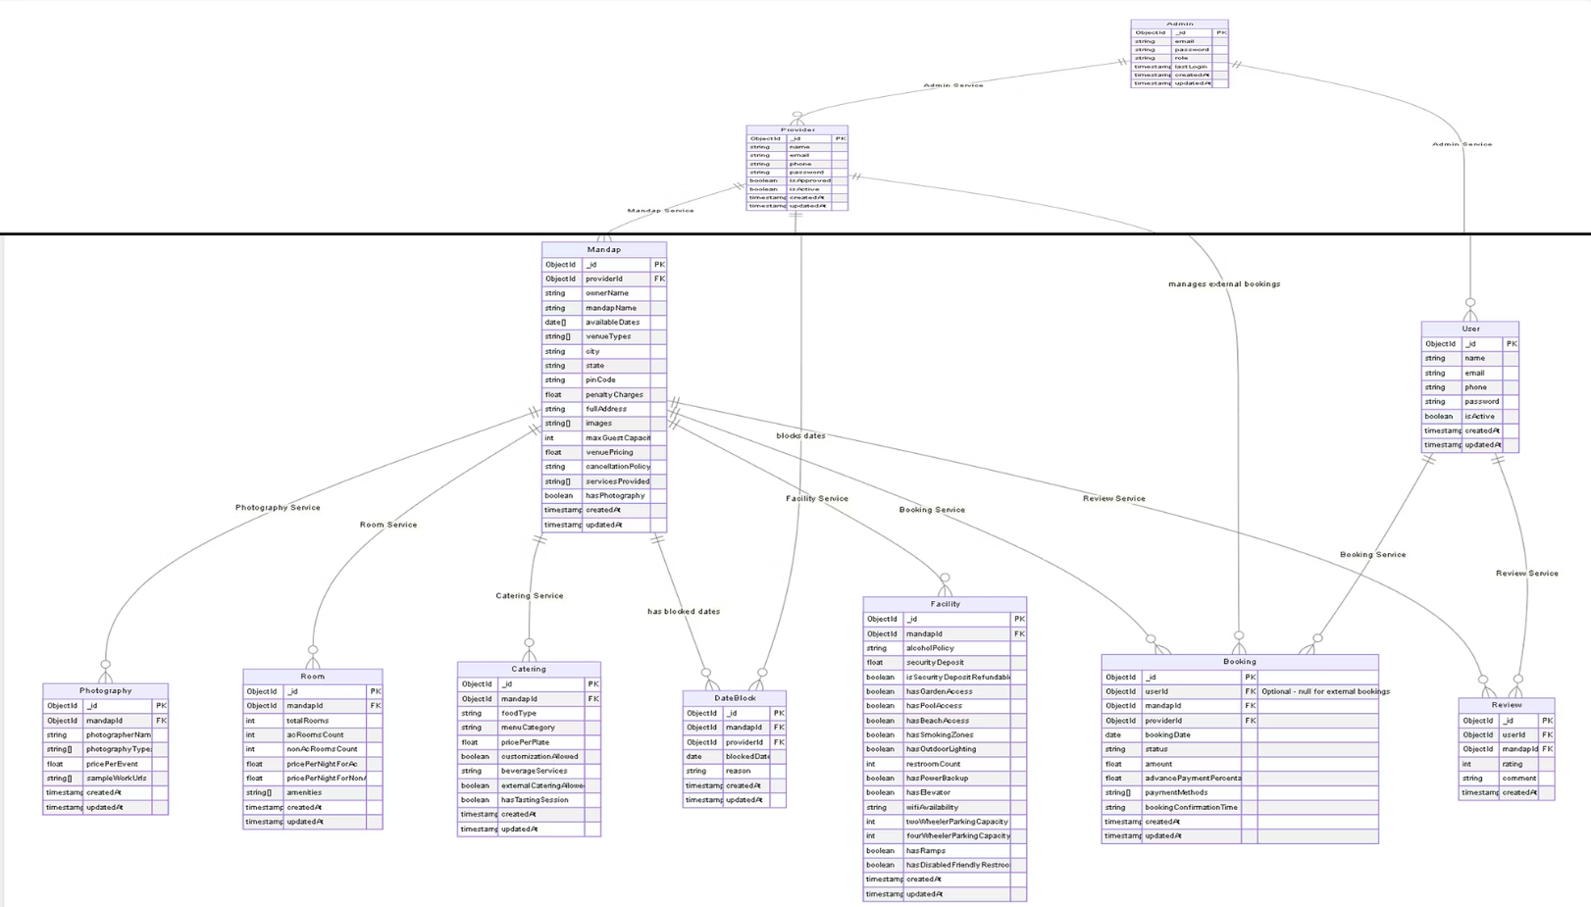

Slide 6
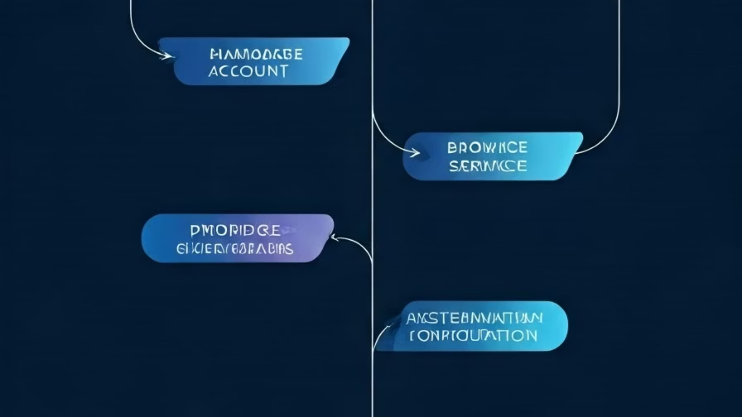
BookMyMandap Use Case Diagrams
Explore the core actors driving our platform: Users, Providers, and Admins.

Slide 7
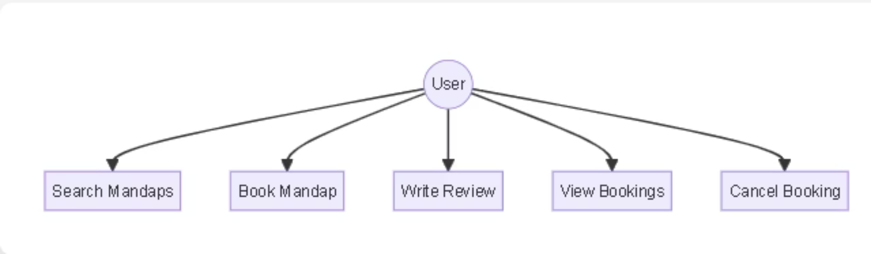
User's Use Case Diagram

Slide 8
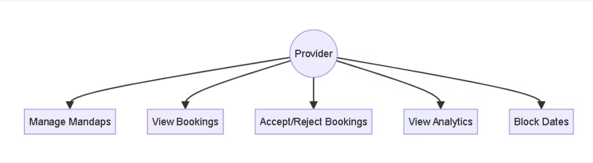
Provider's Use Case Diagram

Slide 9
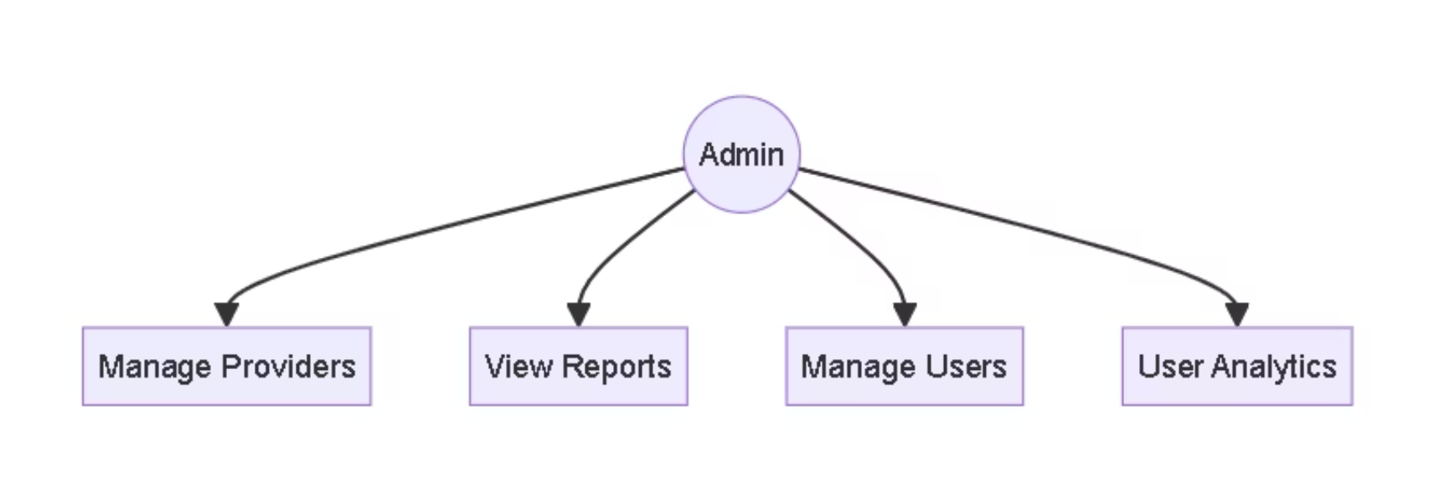
Admin's Use Case Diagram

Slide 10



User Flow Overview
User Journey
Search venues, view availability, book and manage event details seamlessly.
Provider Workflow
Register Mandaps, update listings, manage bookings, and track payments efficiently.
Admin Controls
Oversee platform users, verify providers, and maintain smooth operations securely.

Slide 11
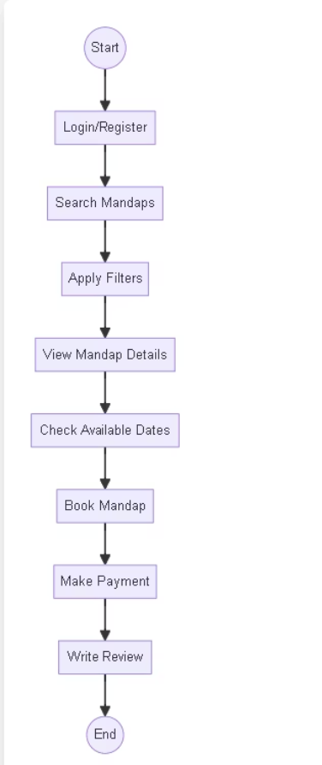
User's User Flow Diagram

Slide 12
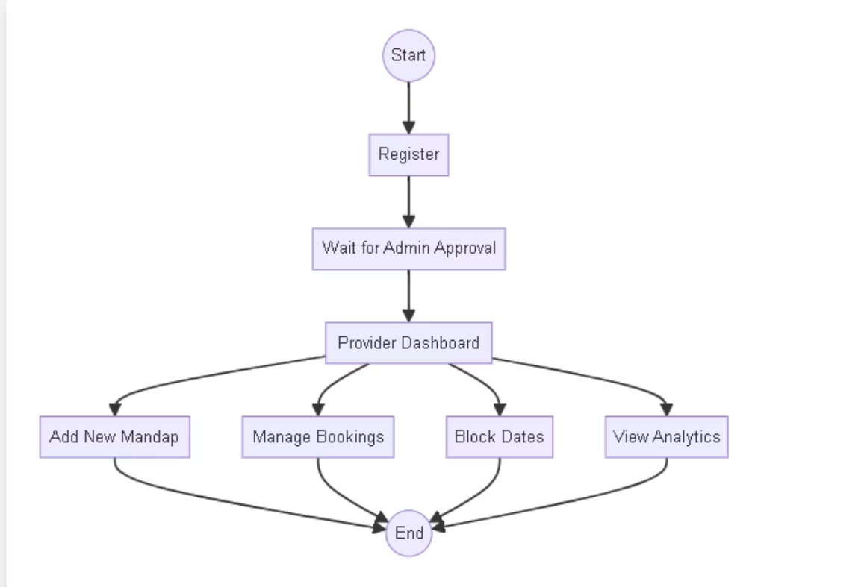
Provider's Flow Diagram

Slide 13
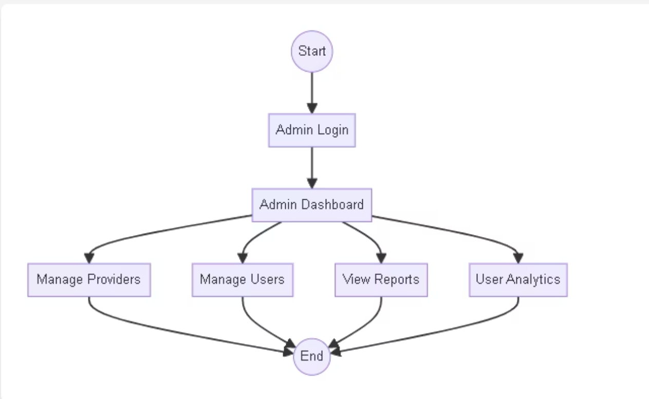
Admin's Flow Diagram

Slide 14

PROVIDER'S PERSPECTIVE

Slide 15
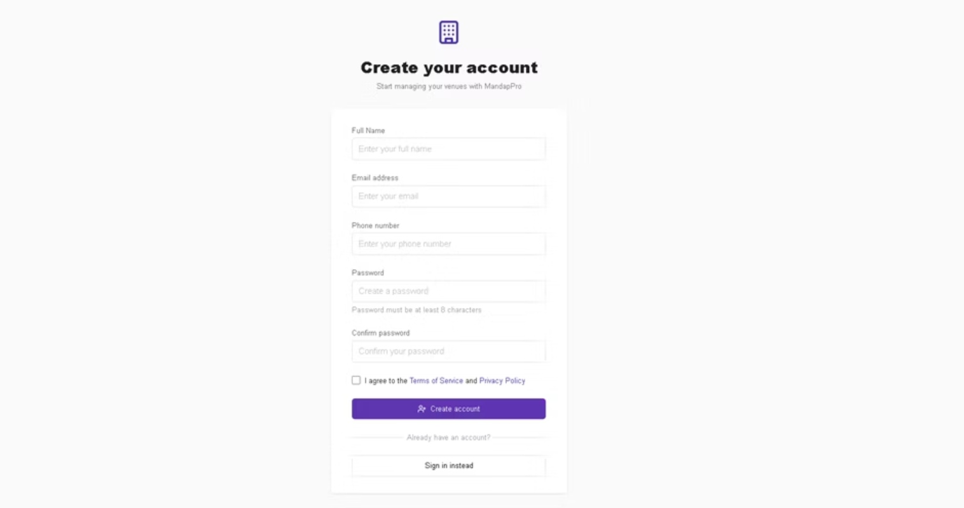
Provider Registration Page

Slide 16
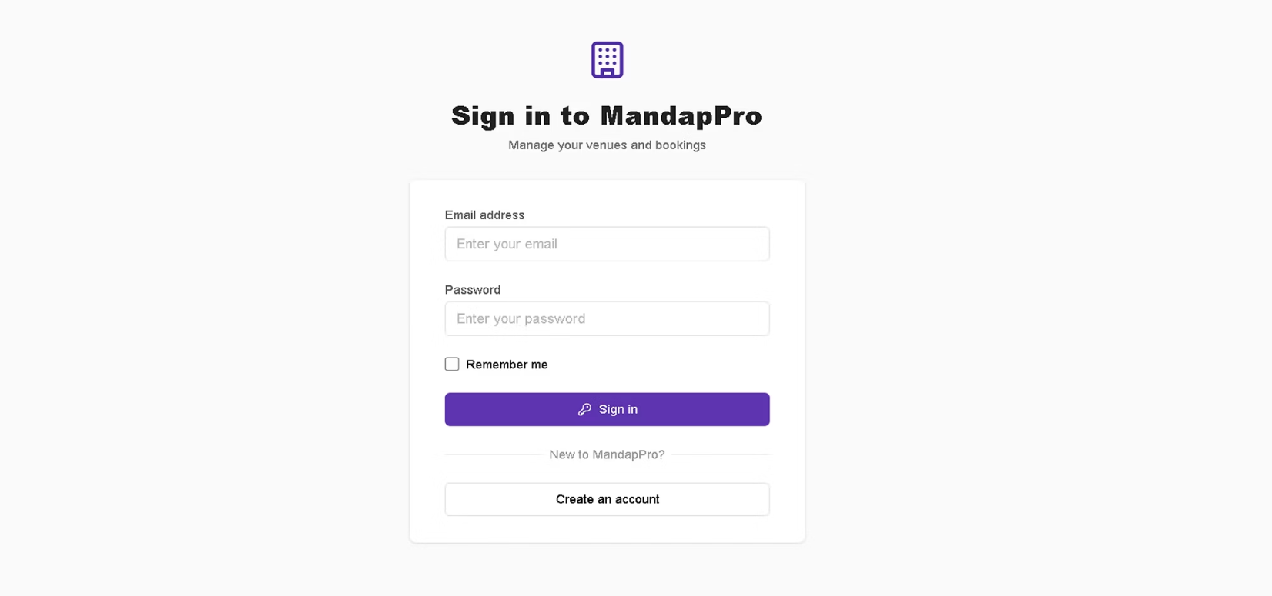
Provider Login Page

Slide 17
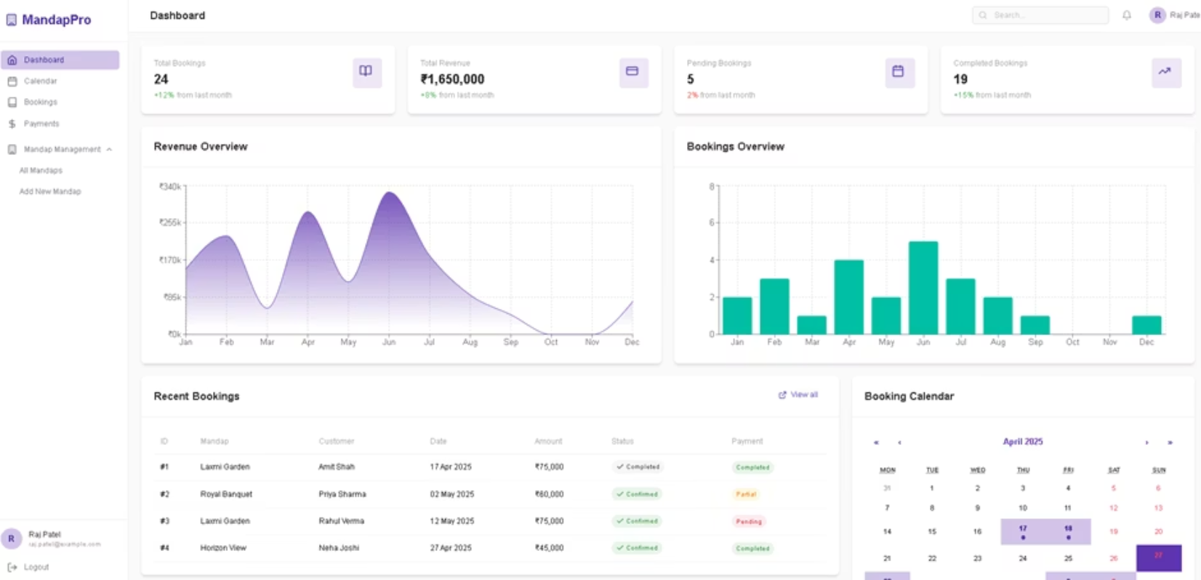
Provider Dashboard

Slide 18
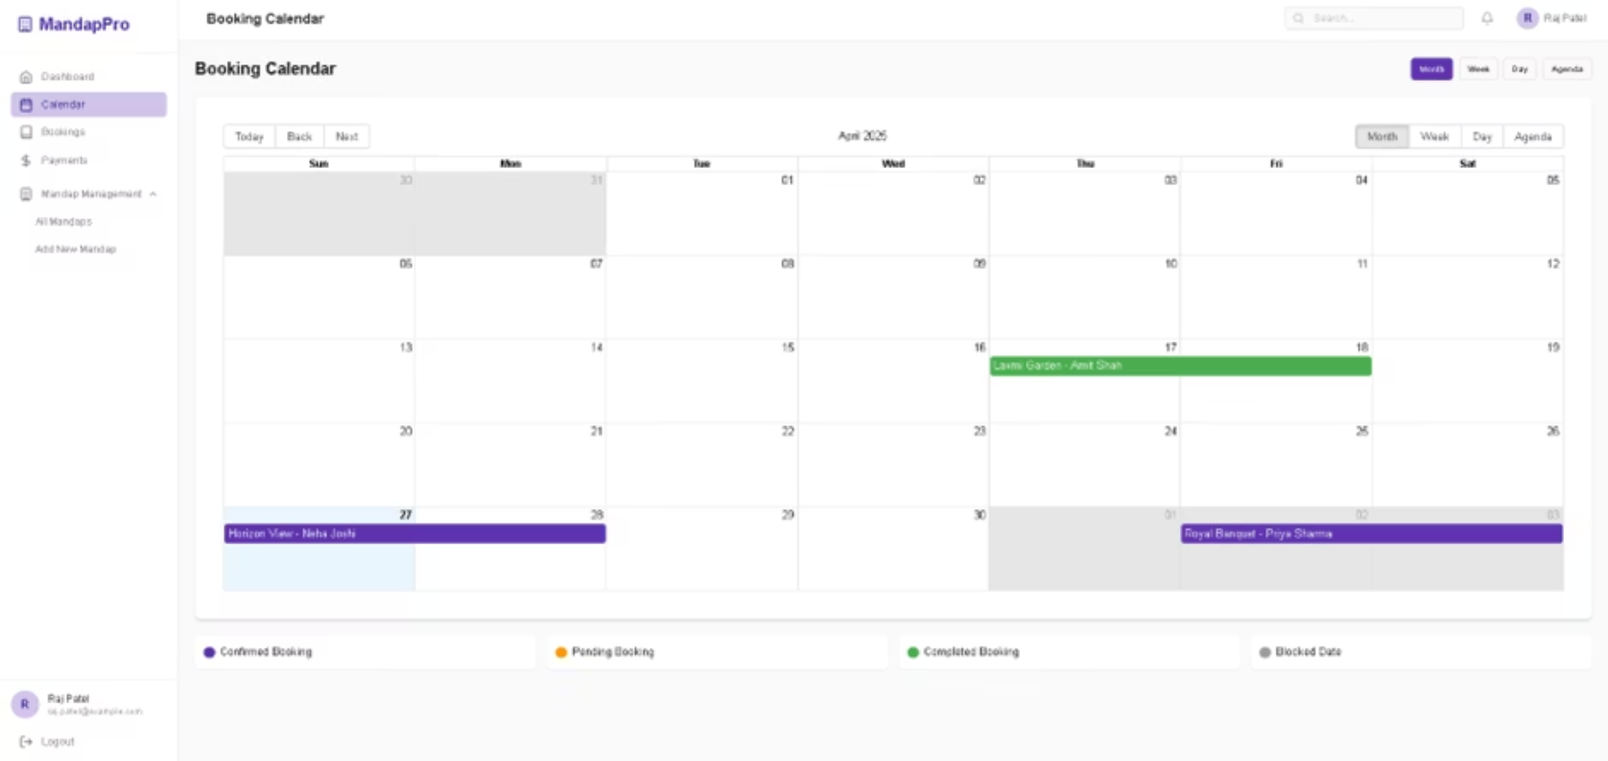
Booking Calendar

Slide 19
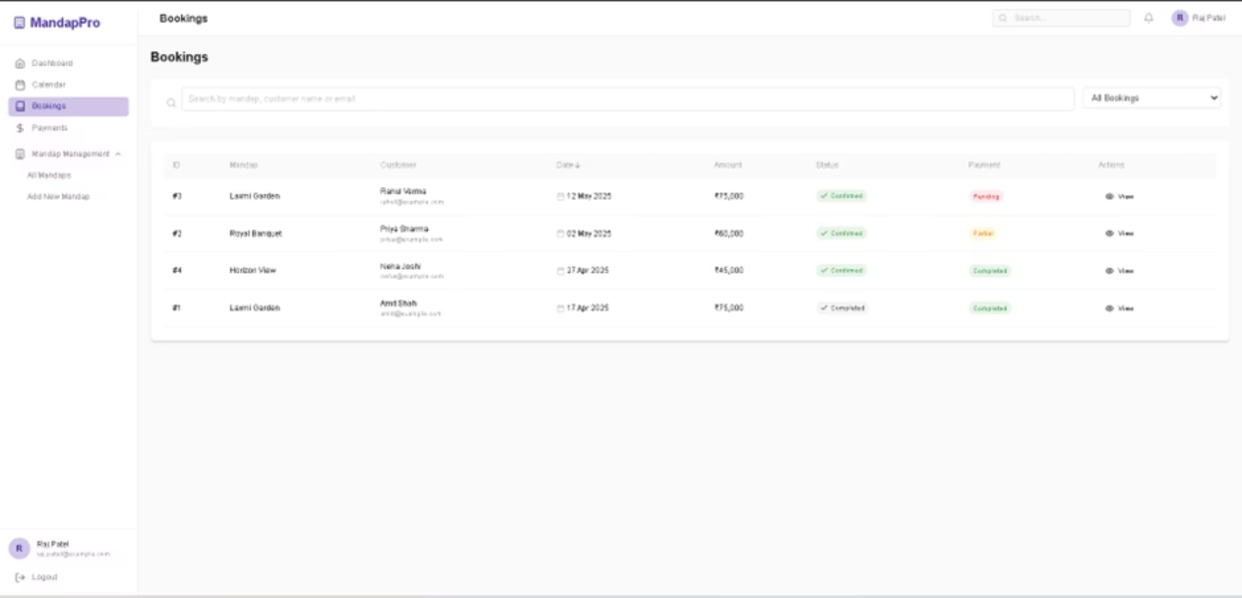
Provider's Bookings

Slide 20
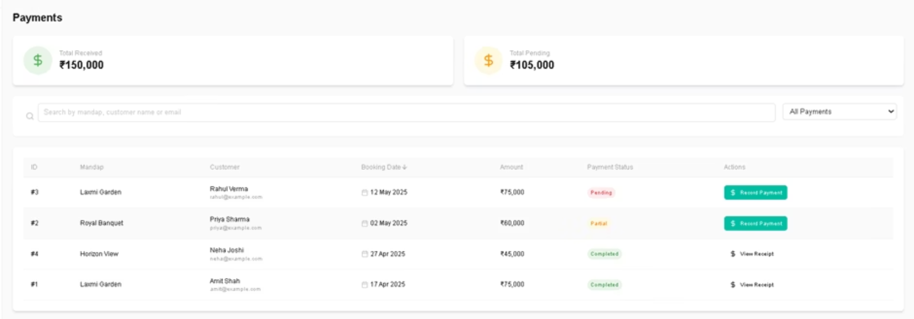
Payment History

Slide 21
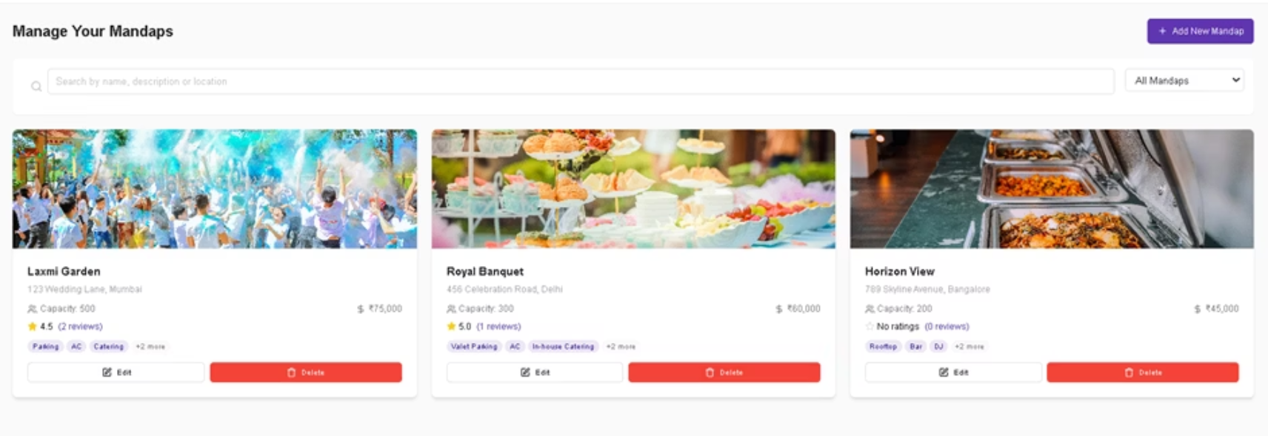
Manage Your Mandap

Slide 22
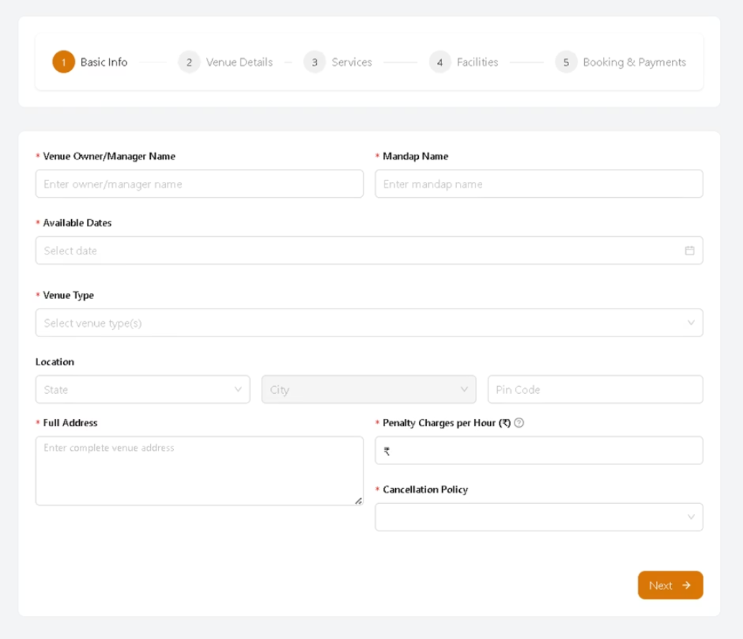
Add New Mandap

Slide 23
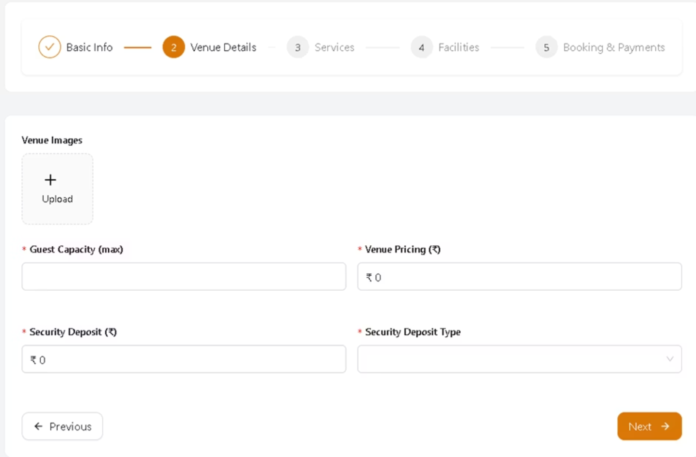

Slide 24
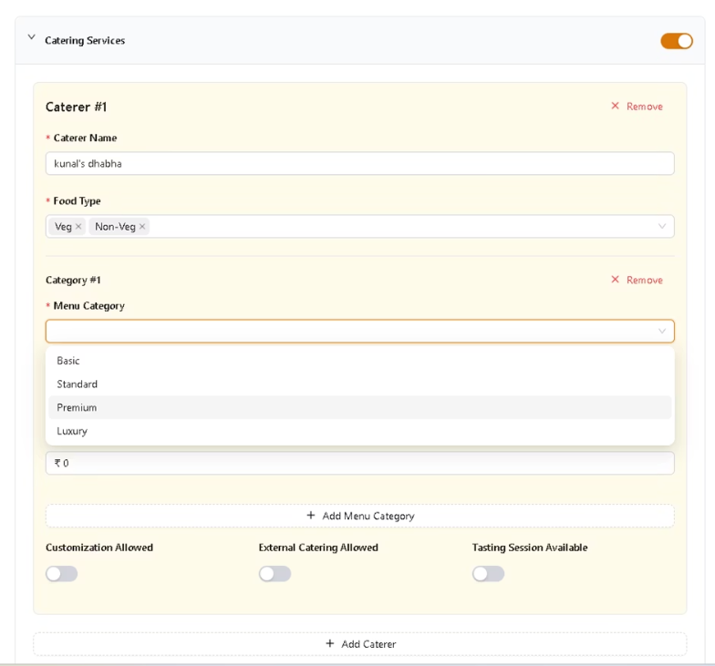
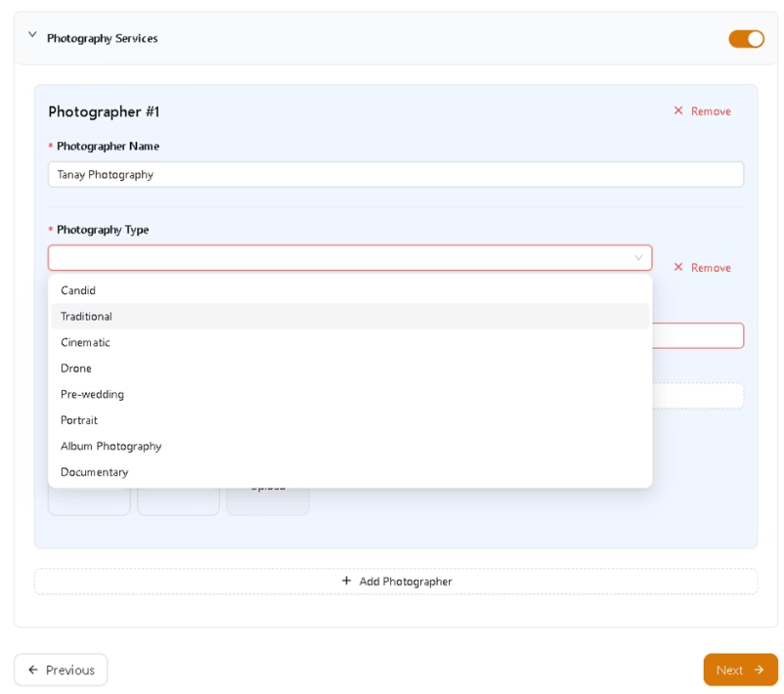

Slide 25
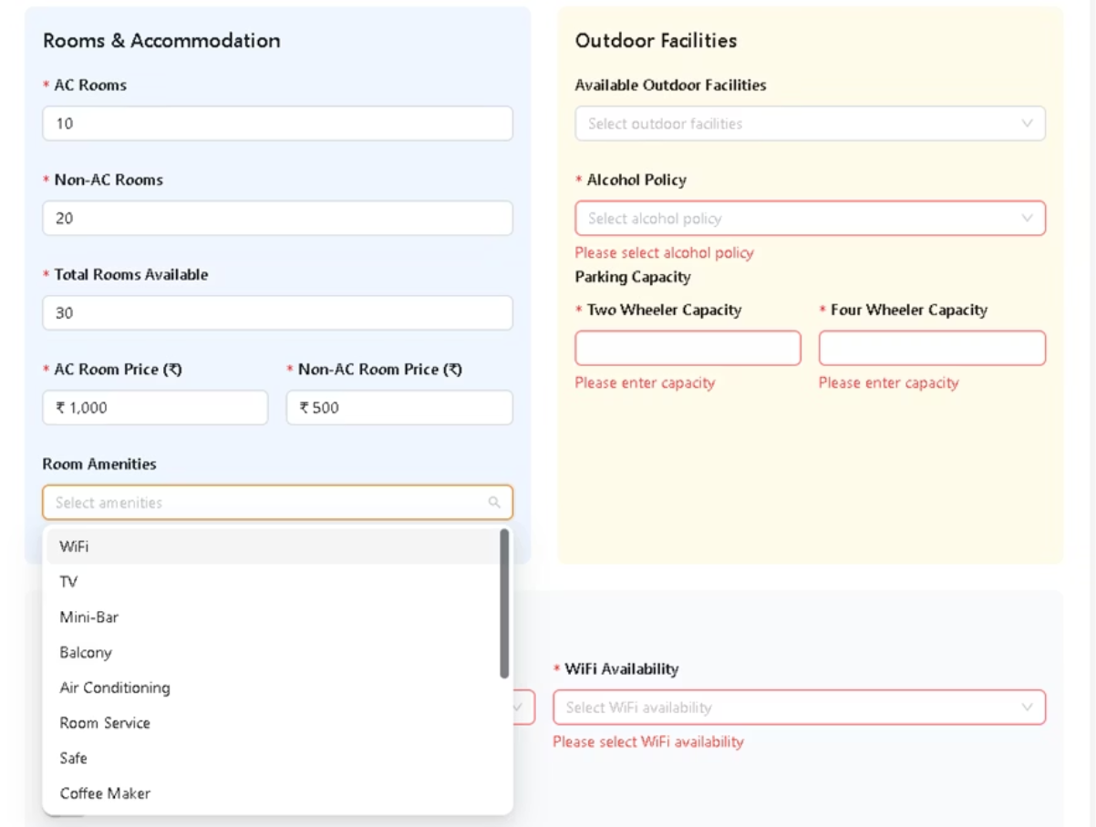

Slide 26
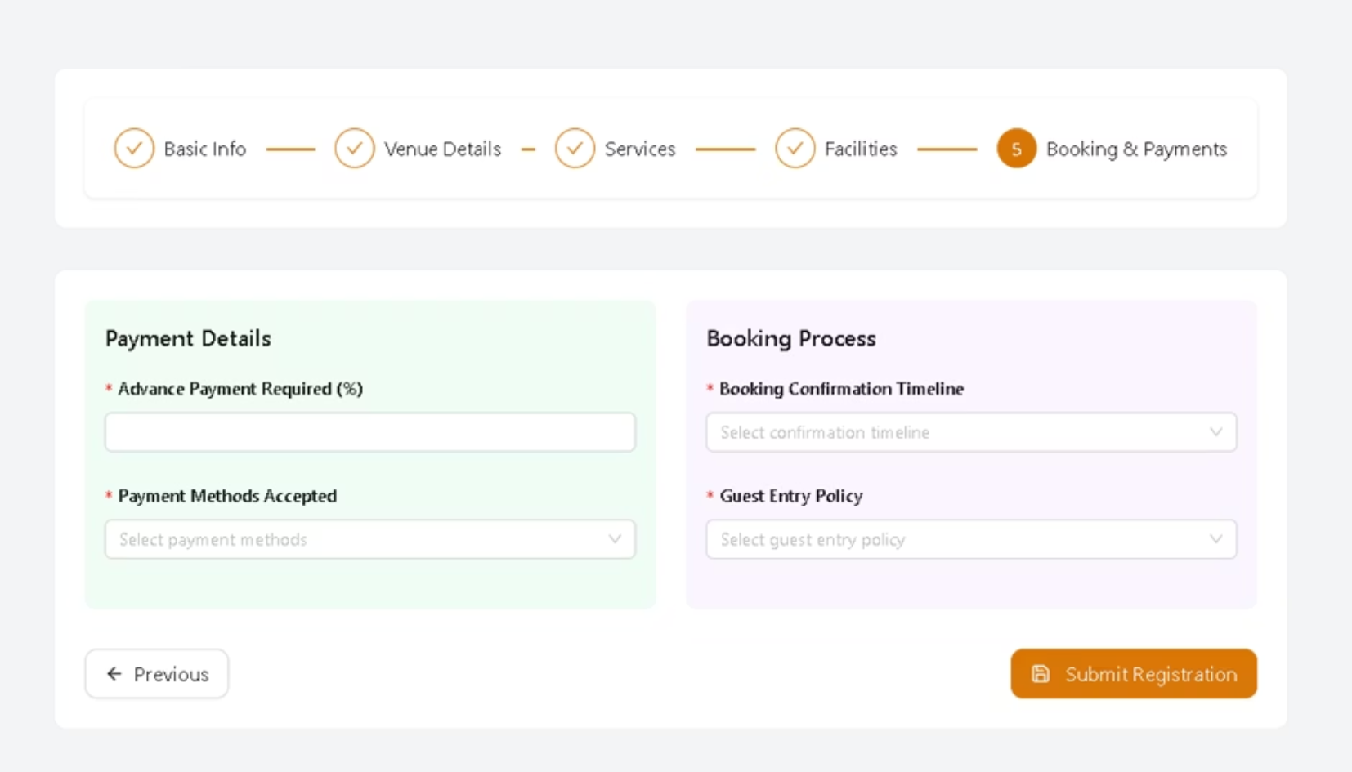

Slide 27

ADMIN PERSPECTIVE

Slide 28
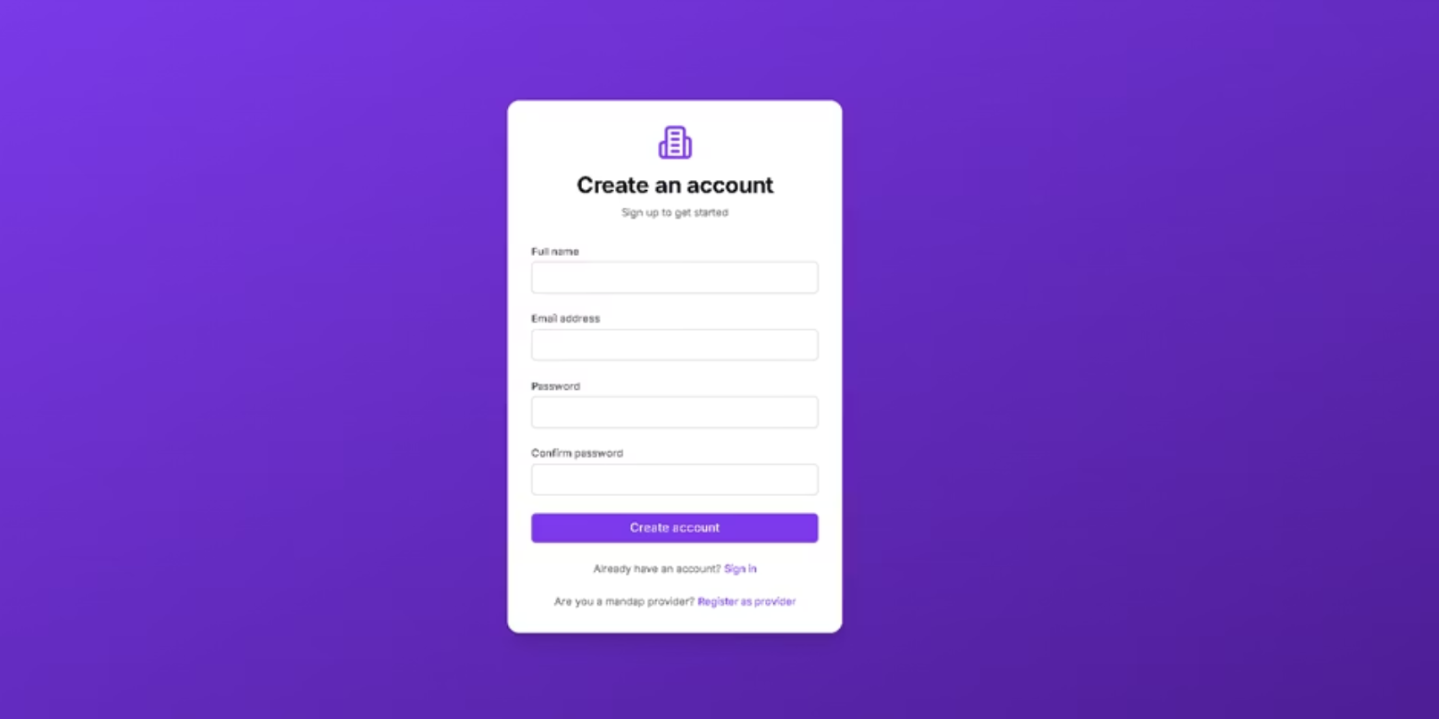
Admin Registration

Slide 29
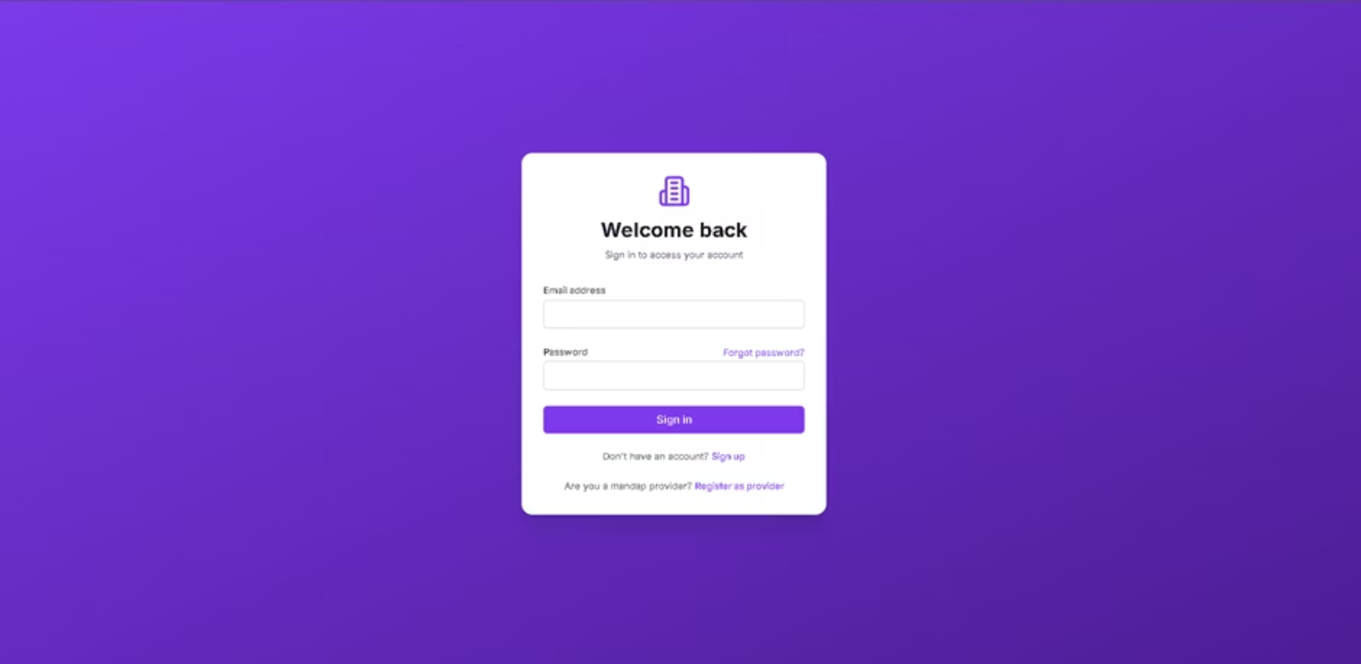
Admin Login

Slide 30
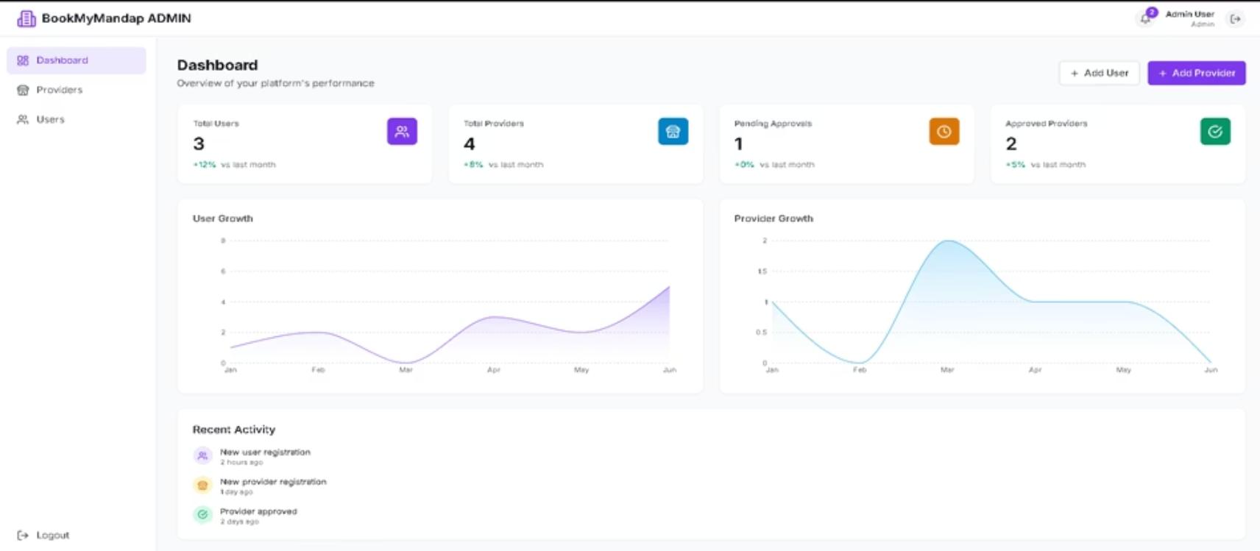
Admin Dashboard

Slide 31
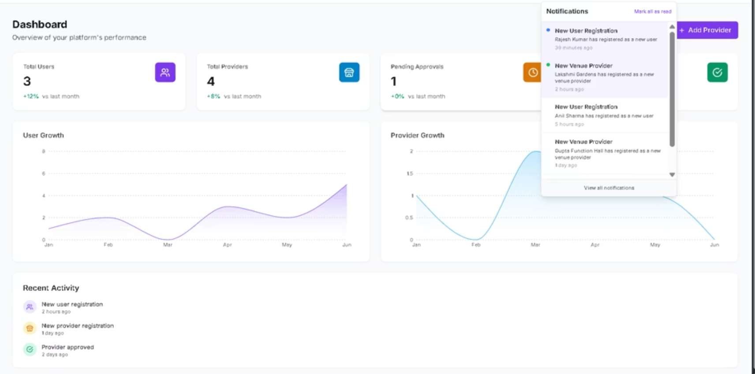

Slide 32
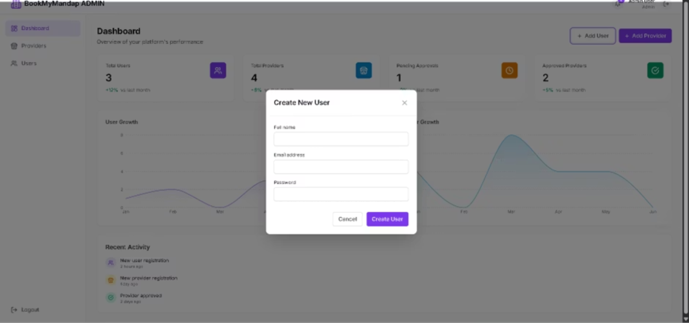
Add User

Slide 33
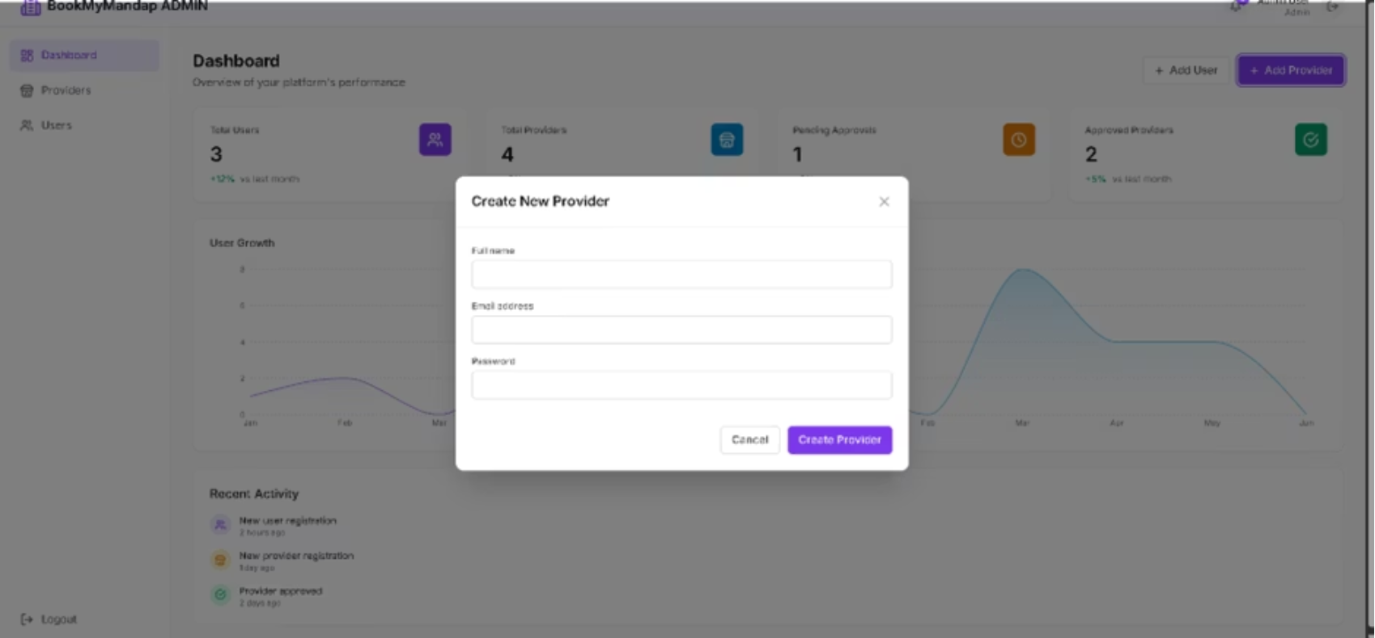
Add Provider

Slide 34
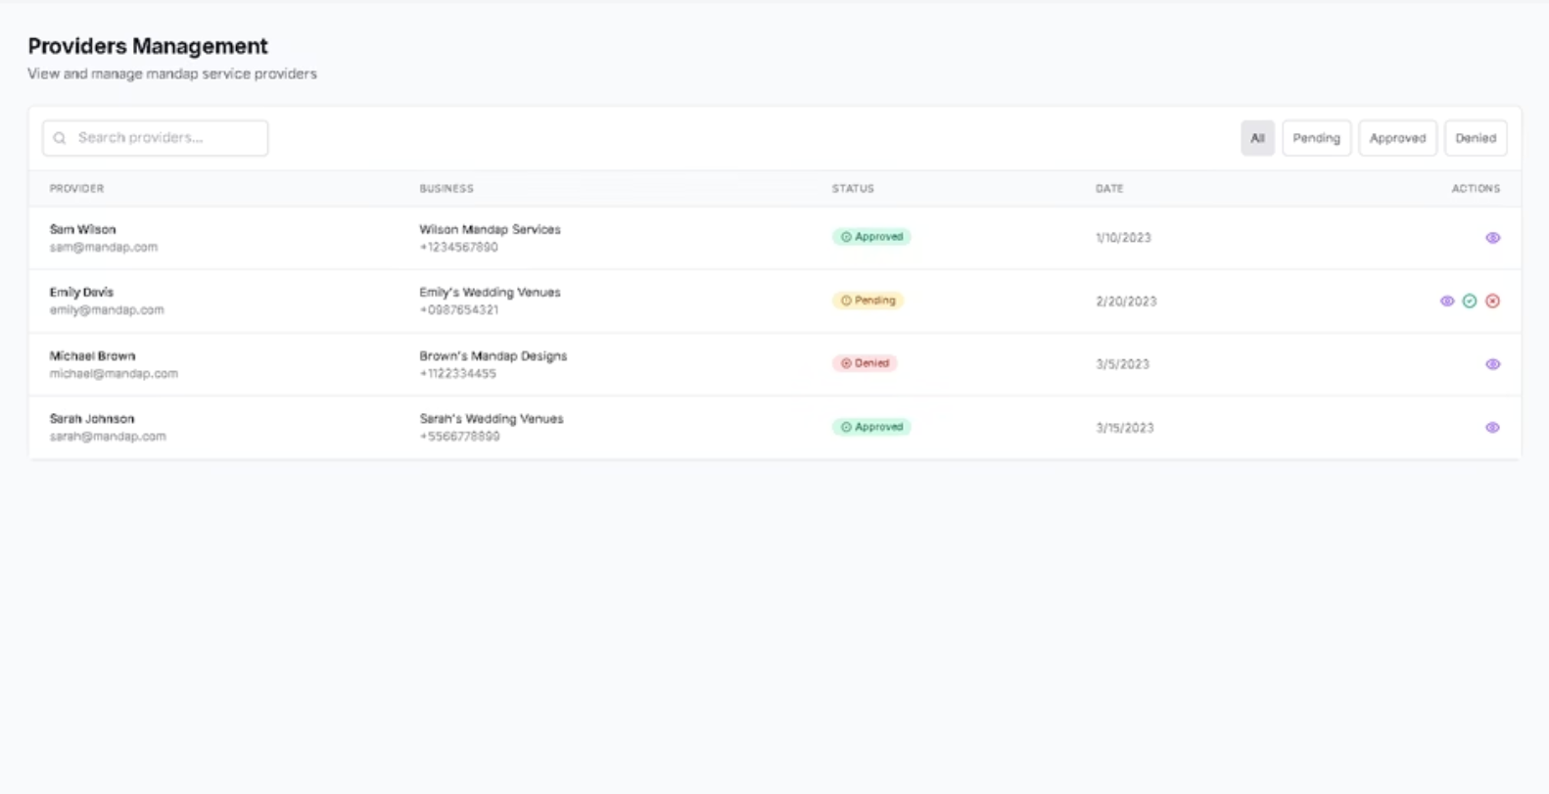
Manage provider

Slide 35
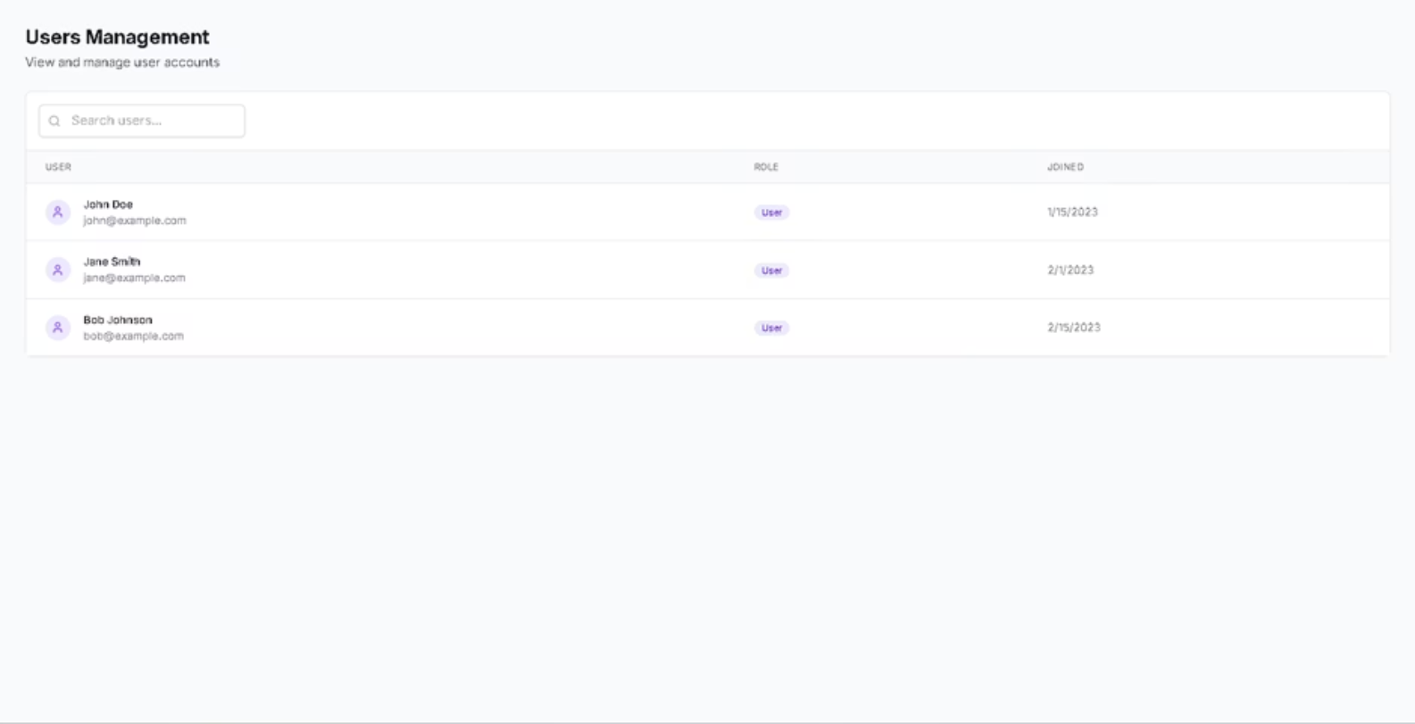
Manage User

Slide 36

BookMyMandap: Let's Create Unforgettable Events Together
Join thousands who trust BookMyMandap for effortless venue booking. Experience the future of event planning with convenience and confidence at your fingertips. Contact us today to learn how we can help make your special day truly unforgettable.

